Slide 1




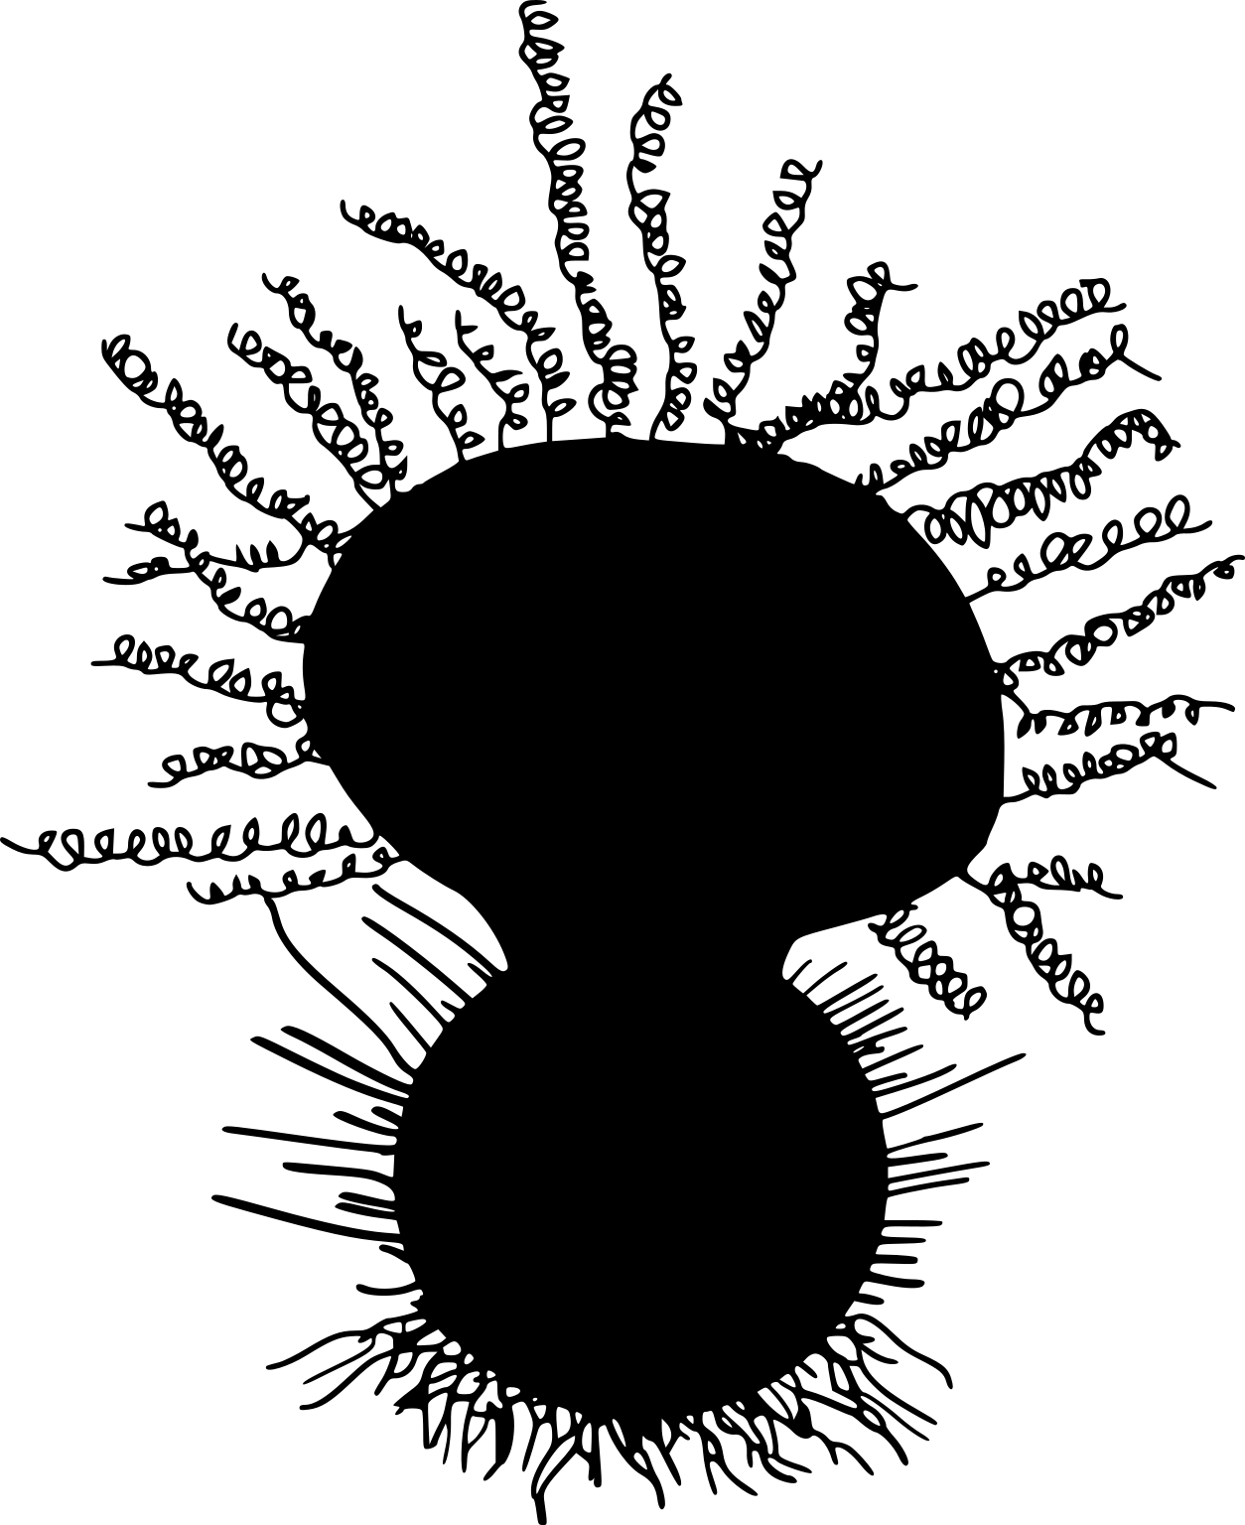





Ciliated Organisms
Non-Ciliated Organisms
Conserved ciliary axoneme
(microtubule doublets)
Rod-cone dystrophy,
Postaxial polydactyly,
Central obesity,
Mental retardation,
Hypogonadism,
Renal dysfunction.
Loss of the sense of smell (anosmia)

